Slide 1
Java Web Connectivity

Slide 2
Web Connectivity
Web
    A global collection of useful resources
    Client-server architecture connecting users (through agents) with web-servers over the internet using standard protocols
    Basic Protocol : HTTP
    Web services support information exchange with other applications
    Applications acts as a client / agent and responsible for interpreting / parsing the resource
Resource Formats
    HTML, XML, JSON, Image, etc
Java API
    URL
    URLConnection and HttpURLConnection

Slide 3
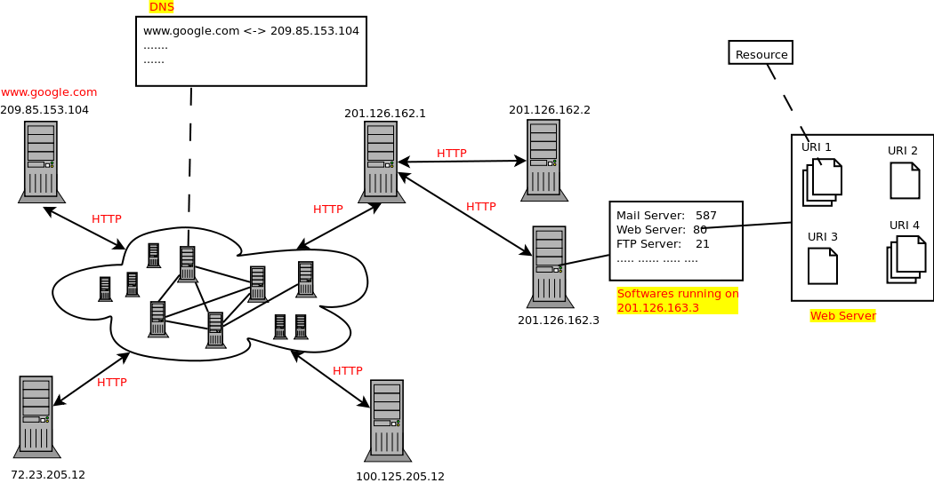
Web Architecture
(Service over Internet)

Slide 4
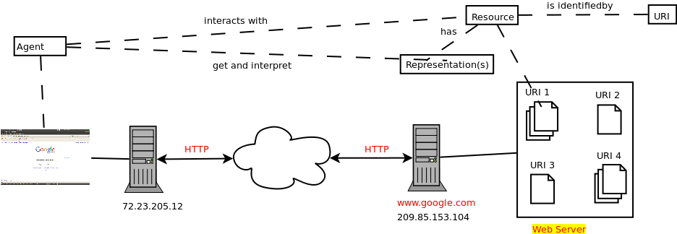
Web Architecture
(Client-Server)
Browser as a (thin) client
Web server holds web content
Browser / Agent presents content to end user
HTTP is used to pull content from server to browser

Slide 5
Web Architecture
(Representational State Transfer i.e. REST)

Slide 6
HTTP Protocol
A simple message-based protocol
Message Types
    Request
      represents client request to access a resource (identified by URI)
      Different request methods supported (e.g. GET, POST, etc)
    Response
      Represents server response capturing resource representation in one of the supported formats
Example request
GET http://www.google.com HTTP/1.1
Host: www.google.com
HTTP/1.1 200
Content-type: text/html
Content-length: xx
<html>
  <head> … </head>
  <body> Google </body>
</html>
Example response

Slide 7
Download data
1. Open connection
with web resource
try{
URL url = new URL("../resource");
HttpURLConnection connection = (HttpURLConnection) url.openConnection();
connection.setReadTimeout(10000);
connection.setConnectTimeout(15000);
connection.setRequestMethod("GET");
connection.setDoInput(true);
connection.connect();
StringBuilder content = new StringBuilder();
BufferedReader reader = new BufferedReader(
new InputStreamReader( connection.getInputStream() ) );
while( (line = reader.readLine()) != null ){
content.append(line);
}
line = content.toString();
parse(line);
} catch(Exception ex) {
ex.printStackTrace();
}
3. Parse
2. Download resource
as a stream

Slide 8
Upload Data
HTTP POST
    Request the web server to accept new (or enhanced) resource content
    Resource is identified by URI
    Content can be of several types identified and interpreted by content-type
    No restrictions on data length
    Used for transmission of data from client to webserver
POST <url> HTTP/1.1
Content-Type: application/json
Content-Length: xxx
{ /* json data */ }

Slide 9
StringBuilder content = new StringBuilder();
try{
URL url = new URL("http://...");
HttpURLConnection connection = (HttpURLConnection) url.openConnection();
connection.setReadTimeout(10000);
connection.setConnectTimeout(15000);
connection.setRequestMethod("POST");
connection.setRequestProperty("Content-type","application/json");
connection.setDoOutput(true);
connection.connect();
BufferedWriter writer = new BufferedWriter (new OutputStreamWriter(connection.getOutputStream());
writer.write(“{/* json data */}”);
writer.flush();
BufferedReader reader = new BufferedReader( new InputStreamReader(connection.getInputStream()));
String line = "";
while( (line = reader.readLine()) != null ){
content.append(line);
}
connection.disconnect();
} catch(Exception ex) {
ex.printStackTrace();
}
return content.toString();
Upload data
1. Open connection
using POST request
2. write data
3. read response

